Slide 1
TEXT EXTRACTION SYSTEM
Project Title
By:
Upendra singh

Slide 2
What is Text extraction system?
A text extraction system is a tool or program that can find and pull-out text from an image or document.
It works by using special technology to recognize the letters, words, and sentences in the picture.
This system helps you get text from pictures, scanned documents, or screenshots, making it easy to copy, edit, or use the text in other ways.

Slide 3
Technology used :-
Backend (Python):
• Flask for routing and request handling.
• Tesseract (OCR) for text extraction from images.
• OpenCV (cv2) for image preprocessing.
Frontend:
• HTML for structuring the content and layout.
• CSS for styling the webpage.
• JavaScript for interactive behavior, like form submission, file handling, dynamic content updates, and enabling/disabling buttons based on the process state
Database:
• SQLite for storing user data and extracted text.
• SQLAlchemy for simplifying database operations in Python.

Slide 4
ER-DIAGRAM
Username
id
Password
USER
Upload image and get extracted text
Can see history
1
M
EXTRACTED TEXT
User_ID
Created_Date
id
Text

Slide 5
Data Flow Diagram (DFD)
Upload Image
Zero Level DFD -
Get Extracted Text
Login
Text Extraction system
USER
0.0
USER
Resister

Slide 6
1.0
Store user detail
Register
USER
USER
Register successful
Generate username & password
Register
Login with Generated username & password
First Level DFD -
2.0
Entered detail
Login
Response (login successful/wrong detail)
Upload
3.0
Image
5.0
History
process
Generate
Store data
Save Text
4.0
Extracted Text
Text Fetch by user
Extracted Text

Slide 7
USER
Upload image
3.1
Uploaded Image
Read Image with OCR
Second Level DFD -
Text Fetch by user
3.2
Read Text, Present in Image
Get Extracted Text
3.1
Show Extracted Text
Save Text
Extracted Text

Slide 8
DATABSE TABLE STRUCTURE
Table Name: User
Primary key: id
Description: this table store the details of user.
Attribute | Data Type | Size | Constraints | Description
id | integer | - | Primary key | Id of text
user_id | integer | - | foreign key | Id of user
text | text | - | Not Null | Extracted text
created_at | datetime | - | - | Time and date of extracted text
Table Name: extracted_text
Primary key: id
Description: this table store the details of extracted texts
Attribute | Data Type | Size | Constraints | Description
id | integer | - | Primary key | Id of user
username | varchar | 50 | Not Null | Name of user
password | varchar | 50 | Not Null | Pass of user

Slide 9
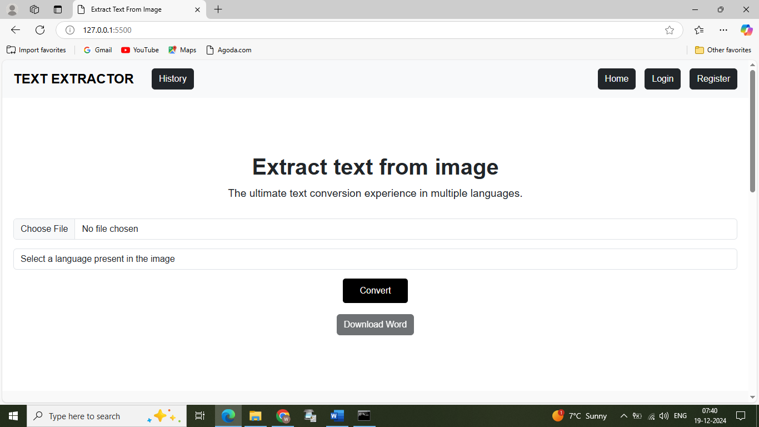
Input & Output Screen
Home Page -

Slide 10
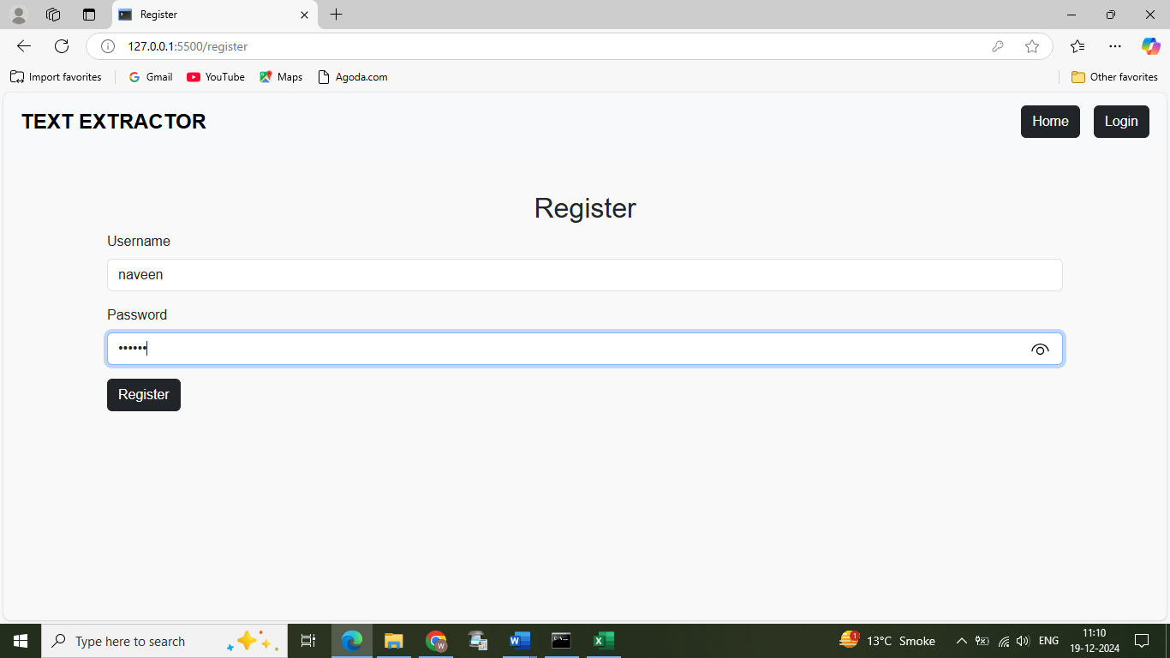
Register Page -

Slide 11
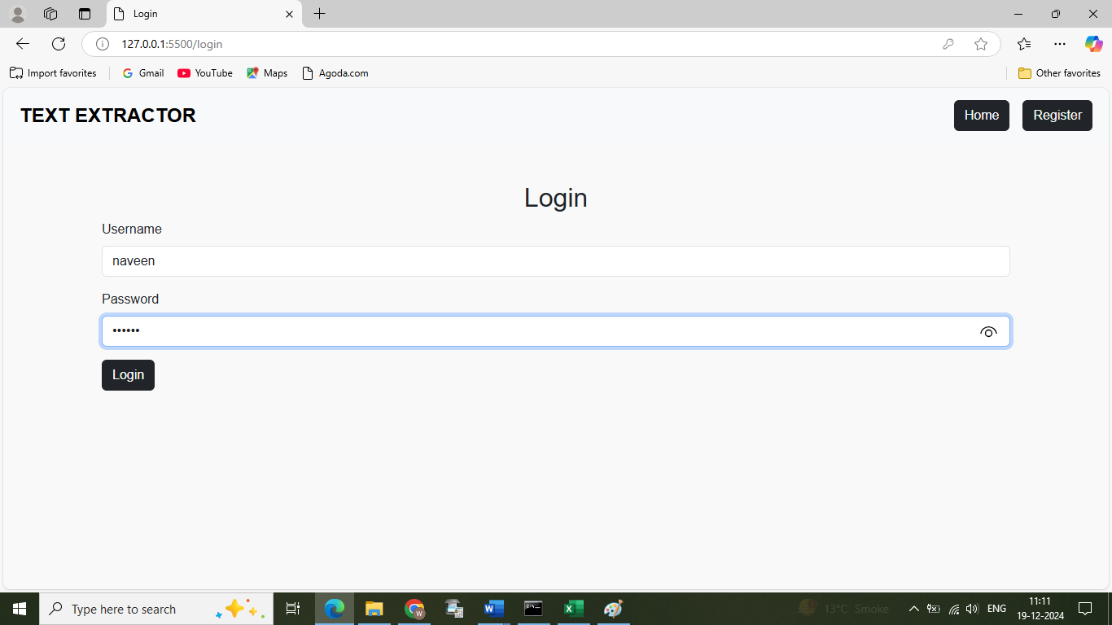
Login Page -

Slide 12
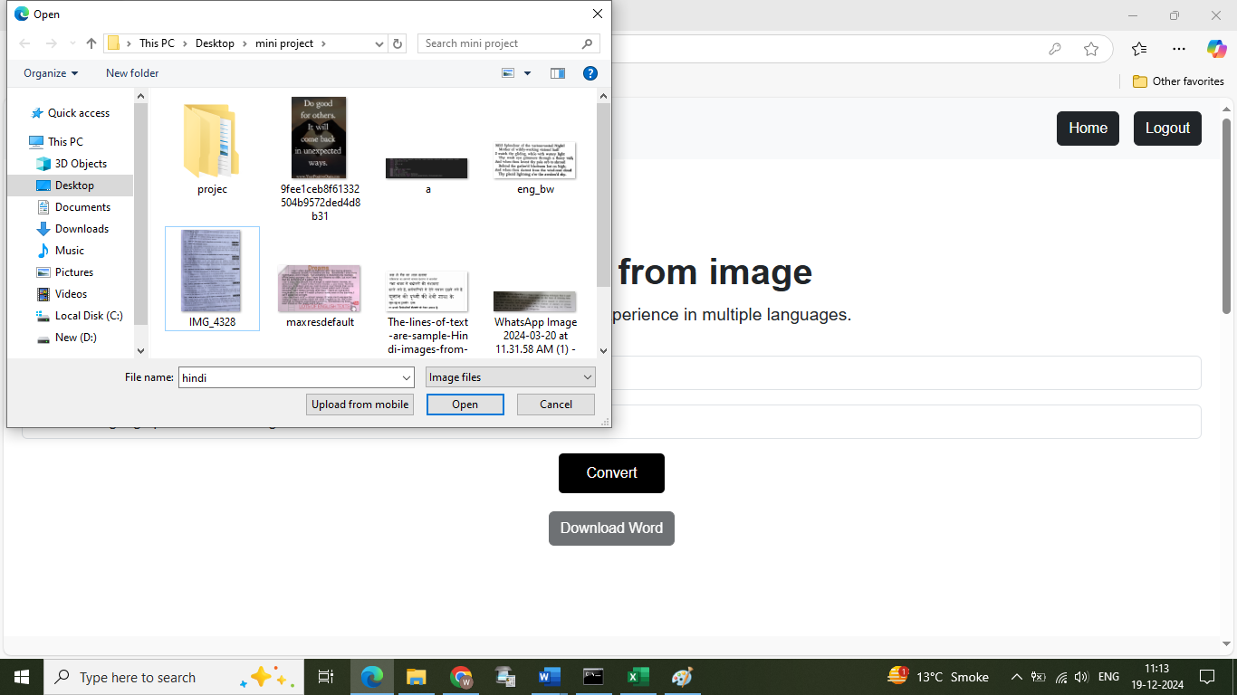
Image Upload -

Slide 13
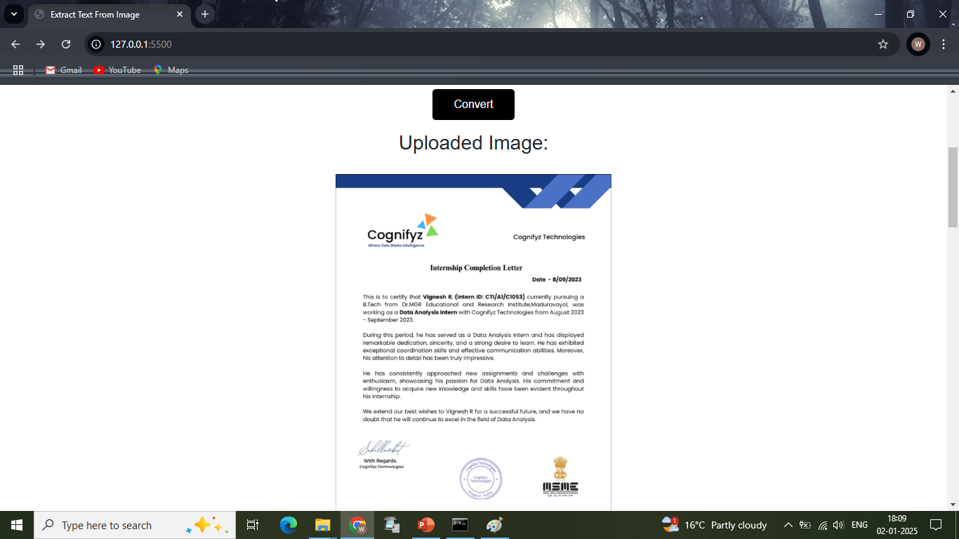
Uploaded Image -

Slide 14
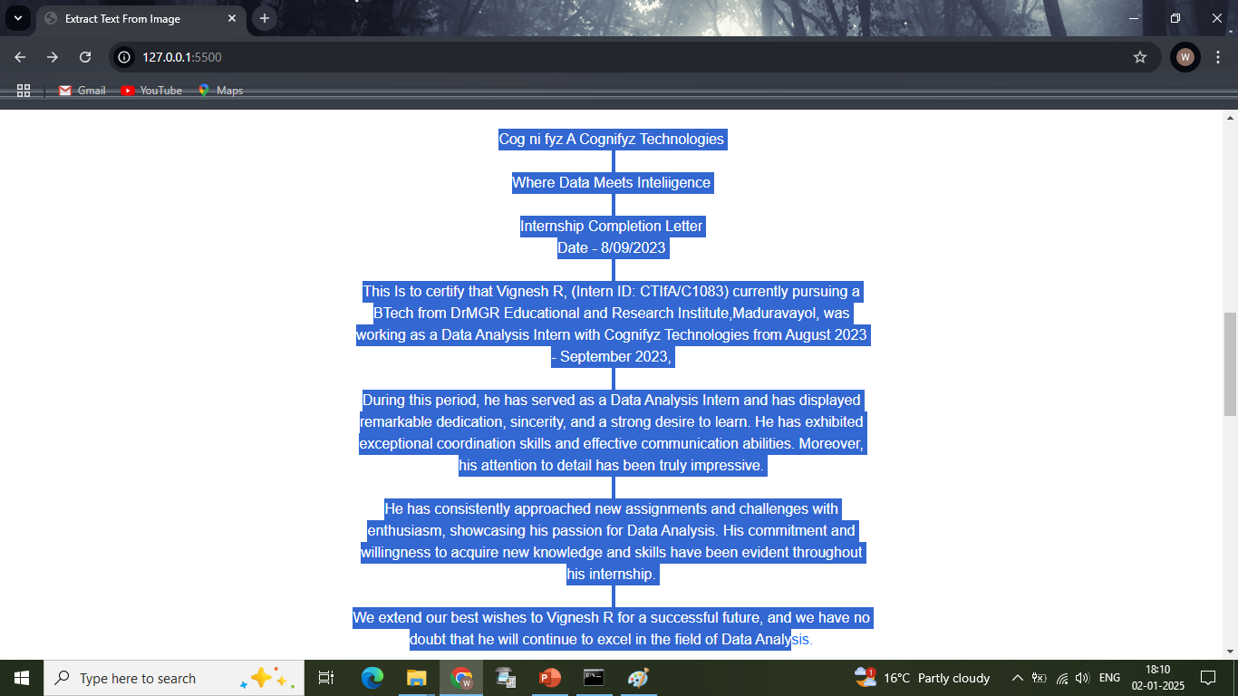
Extracted Text-

Slide 15
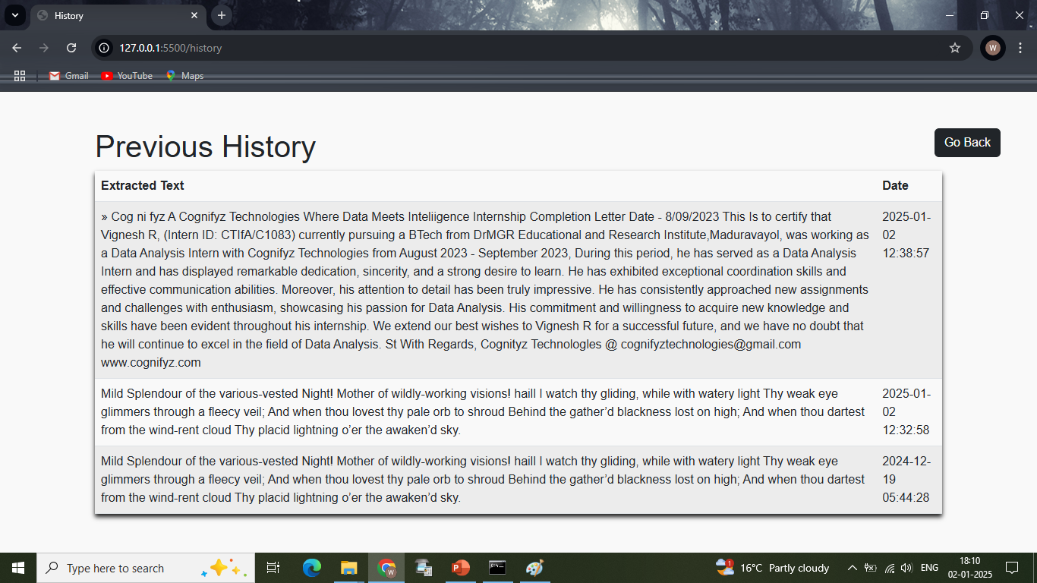
History -

Slide 16
Future scope
Enhanced User Experience
Improved Accuracy and Efficiency
Create Mobile Application

Slide 17
Thank you for your attention!

